Slide 1
Chapter 3 Functions

Slide 2
Defining a function
A function definition is a regular binding where the value of the binding is a function. For example, this code defines square to refer to a function that produces the square of a given number:
const square = function(x) {
return x * x;
};
console.log(square(12));
// → 144
Notes:
A function is created with an expression that starts with the keyword function
. Functions have a set of parameters (in this case, only x) and a body, which
contains the statements that are to be executed when the function is called.
The function body of a function created this way must always be wrapped in
braces, even when it consists of only a single statement.

Slide 3
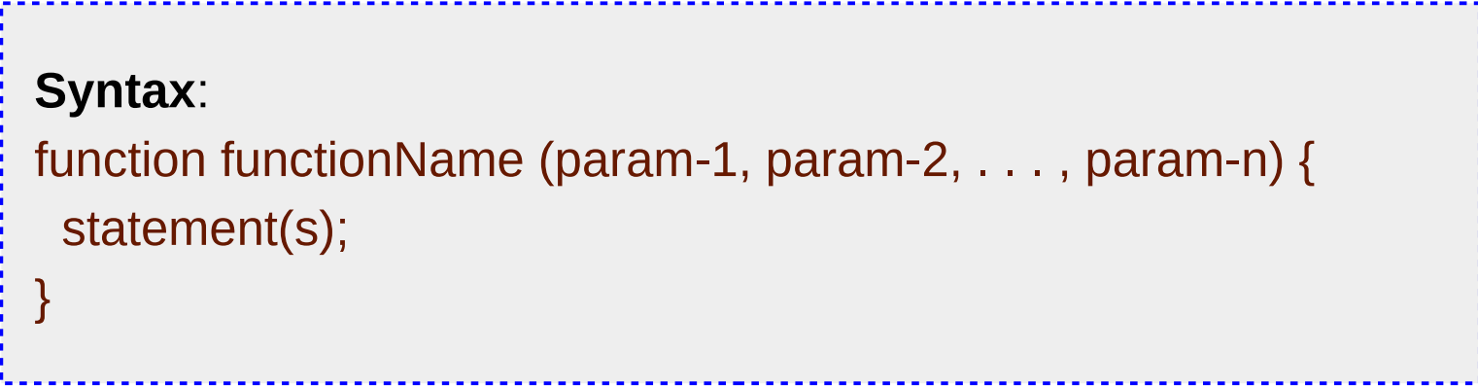
Defining a function

Slide 4
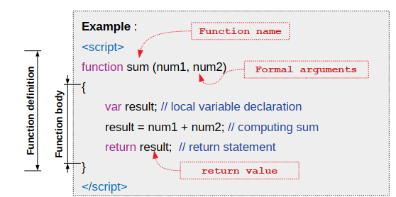
Function Example

Slide 5
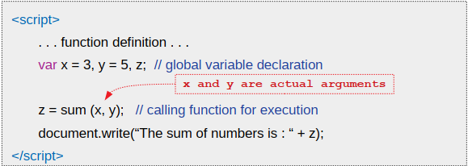
Function Execution
Merely defining a function does not result in execution of the function; it must be called for execution

Slide 6
Actual Vs formal arguments
● Formal arguments are the names listed within parenthesis in function definition (also known as function parameters) ● Formal arguments are initialized through actual arguments at run time ● Actual arguments are variables or literals passed to the function at the time of invocation (call to execute) ● The formal arguments are visible to function only

Slide 7
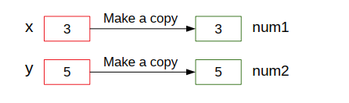
Actual Vs formal arguments
The value from actual argument is copied to formal arguments before executing the body of function

Slide 8
Cont.…
A function can have multiple parameters or no parameters at all. In the following example, makeNoise does not list any parameter names, whereas power lists two:
const makeNoise = function() {
console.log("Pling!");
};
makeNoise();
// → Pling!

Slide 9
Cont.…
const power = function(base, exponent) {
let result = 1;
for (let count = 0; count < exponent; count++) {
result *= base;
}
return result;
};
console.log(power(2, 10));
// → 1024
Notes:
Some functions produce a value, such as power and square, and some don’t,
such as makeNoise, whose only result is a side effect. A return statement
determines the value the function returns. When control comes across such
a statement, it immediately jumps out of the current function and gives the
returned value to the code that called the function. A return keyword without
an expression after it will cause the function to return undefined. Functions
that don’t have a return statement at all, such as makeNoise, similarly return
undefined.
Parameters to a function behave like regular bindings, but their initial values
are given by the caller of the function, not the code in the function itself.

Slide 10
The return statement
● By default a function returns undefined ● Return statement is used to return primitive value or reference of an object ● The return value or reference – Can be directly passed on to expressions – Must be collected using assignment operator to store in a variable and further utilization ● There could be more than one return statements present in the function; but, only one value or reference can be returned ● The function exits after execution of return statement

Slide 11
Bindings and scopes or Local and Global Variables
Each binding has a scope, which is the part of the program in which the binding is visible. For bindings defined outside of any function or block, the scope is the whole program—you can refer to such bindings wherever you want. These are called global.
But bindings created for function parameters or declared inside a function can be referenced only in that function, so they are known as local bindings.

Slide 12
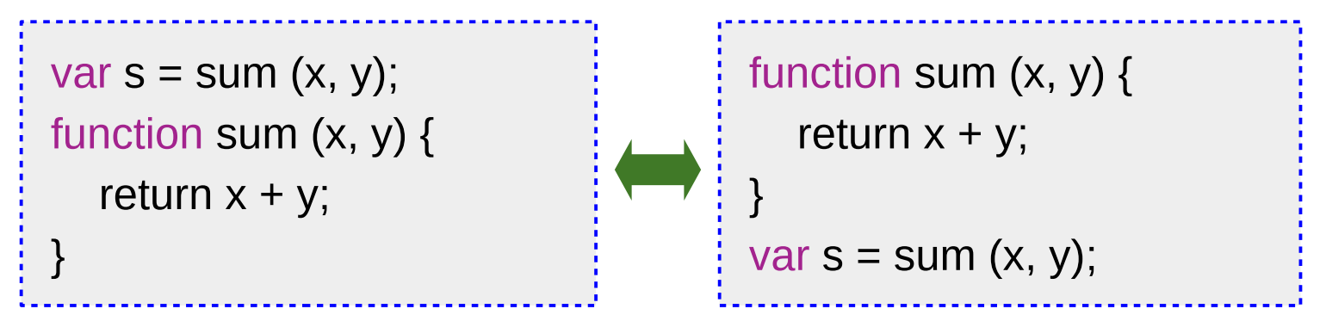
Function Hoisting
JavaScript moves variable and function declarations to top of the current scope; this is called hoisting ● Due to hoisting JavaScript functions can be called before they are declared

Slide 13
Con…
Every time the function is called, new instances of these bindings are created
let x = 10;
if (true) {
let y = 20;
var z = 30;
console.log(x + y + z);
// → 60
}
// y is not visible here
console.log(x + z);
// → 40.
Notes:
This provides some isolation between functions—each function call acts in its
own little world (its local environment) and can often be understood without
knowing a lot about what’s going on in the global environment.
Bindings declared with let and const are in fact local to the block that they
are declared in, so if you create one of those inside of a loop, the code before and
after the loop cannot “see” it. In pre-2015 JavaScript, only functions created
new scopes, so old-style bindings, created with the var keyword, are visible
throughout the whole function that they appear in—or throughout the global
scope, if they are not in a function.

Slide 14
Con…
Each scope can “look out” into the scope around it, so x is visible inside the block in the example. The exception is when multiple bindings have the same name—in that case, code can see only the innermost one. For example, when the code inside the halve function refers to n, it is seeing its own n, not the global n.
const halve = function(n) {
return n / 2;
};
let n = 10;
console.log(halve(100));
// → 50
console.log(n);
// → 10

Slide 15
Nested scope
JavaScript distinguishes not just global and local bindings. Blocks and functions
can be created inside other blocks and functions, producing multiple degrees
of locality.
var name = 'Peter';
function greet() {
var greeting = 'Hello';
{
let lang = 'English';
console.log(`${lang}: ${greeting} ${name}`);
}
}
greet();

Slide 16
Functions as values
A function binding usually simply acts as a name for a specific piece of the program. Such a binding is defined once and never changed. This makes it easy to confuse the function and its name.
But the two are different. A function value can do all the things that other values can do—you can use it in arbitrary expressions, not just call it. It is possible to store a function value in a new binding, pass it as an argument to a function, and so on. Similarly, a binding that holds a function is still just a regular binding and can, if not constant, be assigned a new value, like so:
function square(x) { return x*x; }
var s = square; // Now s refers to the same function that square does
square(4); // => 16
s(4); // => 16

Slide 17
Declaration notation
There is a slightly shorter way to create a function binding. When the function keyword is used at the start of a statement, it works differently.
function square(x) {
return x * x;
}
///////////
console.log("The future says:", future());
function future() {
return "You'll never have flying cars";
}
Notes:
There is a slightly shorter way to create a function binding. When the function
keyword is used at the start of a statement, it works differently.
This is a function declaration. The statement defines the binding square and
points it at the given function. It is slightly easier to write and doesn’t require
a semicolon after the function.
There is one subtlety with this form of function definition.
The preceding code works, even though the function is defined below the code
that uses it. Function declarations are not part of the regular top-to-bottom
flow of control. They are conceptually moved to the top of their scope and can
be used by all the code in that scope. This is sometimes useful because it offers
the freedom to order code in a way that seems meaningful, without worrying
about having to define all functions before they are used.

Slide 18
Arrow functions
There’s a third notation for functions, which looks very different from the others. Instead of the function keyword, it uses an arrow (=>) made up of an equal sign and a greater-than character (not to be confused with the greaterthan- or-equal operator, which is written >=).
const power = (base, exponent) => {
let result = 1;
for (let count = 0; count < exponent; count++) {
result *= base;
}
return result;
};

Slide 19
When there is only one parameter name, you can omit the parentheses
around the parameter list. If the body is a single expression, rather than a
block in braces, that expression will be returned from the function. So, these two definitions of square do the same thing:
const square1 = (x) => { return x * x; };
const square2 = x => x * x;
When an arrow function has no parameters at all, its parameter list is just
an empty set of parentheses.
const horn = () => {
console.log("Toot");
};

Slide 20
Optional Arguments
The following code is allowed and executes without any problem:
function square(x) { return x * x; }
console.log(square(4, true, "hedgehog"));
// → 16
Notes:
We defined square with only one parameter. Yet when we call it with three,
the language doesn’t complain. It ignores the extra arguments and computes
the square of the first one.
‘

Slide 21
Cont.…
JavaScript is extremely broad-minded about the number of arguments you pass to a function. If you pass too many, the extra ones are ignored. If you pass too few, the missing parameters get assigned the value undefined.
The downside of this is that it is possible—likely, even—that you’ll accidentally pass the wrong number of arguments to functions. And no one will tell you about it.
The upside is that this behavior can be used to allow a function to be called with different numbers of arguments

Slide 22
Cont.…
For example, this minus function tries to Imitate the - operator by acting on either one or two arguments:
function minus(a, b) {
if (b === undefined) return -a;
else return a - b;
}
console.log(minus(10));
// → -10
console.log(minus(10, 5));
// →5

Slide 23
Cont.…
If you write an = operator after a parameter, followed by an expression, the value of that expression will replace the argument when it is not given.
For example, this version of power makes its second argument optional. If you don’t provide it or pass the value undefined, it will default to two, and the function will behave like square.
function power(base, exponent = 2) {
let result = 1;
for (let count = 0; count < exponent; count++) {
result *= base;
}
return result;
}
console.log(power(4));
// → 16
console.log(power(2, 6));
// → 64

Slide 24
Closure
A closure is the combination of a function and the lexical
environment within which that function was declared.
function makeAdder(x) {
return function(y) {
return x + y;
};
}
var add5 = makeAdder(5);
var add10 = makeAdder(10);
console.log(add5(2)); // 7
Notes:
This environment consists of any local variables that were in-scope at the time the closure was created. In this case, myFunc is a reference to the instance of the function displayName created when makeFunc is run. The instance of displayName maintains a reference to its lexical environment, within which the variable name exists. For this reason, when myFunc is invoked, the variable name remains available for use and "Mozilla" is passed to alert.
In this example, we have defined a function makeAdder(x), which takes a single argument, x, and returns a new function. The function it returns takes a single argument, y, and returns the sum of x and y.
In essence, makeAdder is a function factory — it creates functions which can add a specific value to their argument. In the above example we use our function factory to create two new functions — one that adds 5 to its argument, and one that adds 10.
add5 and add10 are both closures. They share the same function body definition, but store different lexical environments. In add5's lexical environment, x is 5, while in the lexical environment for add10, x is 10.
For more info about Closures checkout this link : https://developer.mozilla.org/en-US/docs/Web/JavaScript/Closures

